Slide 1
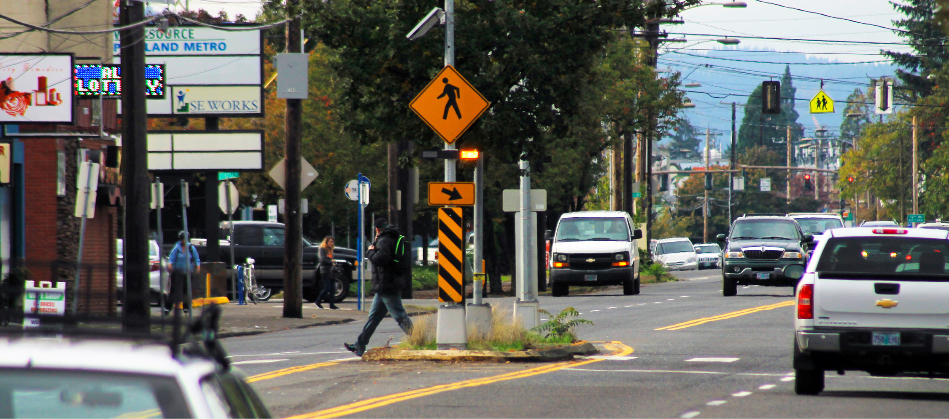
Vision Zero Implementation Lents Neighborhood Association | May 28, 2019

Slide 2
Portland’s goal to eliminate traffic deaths and serious injuries

Slide 3
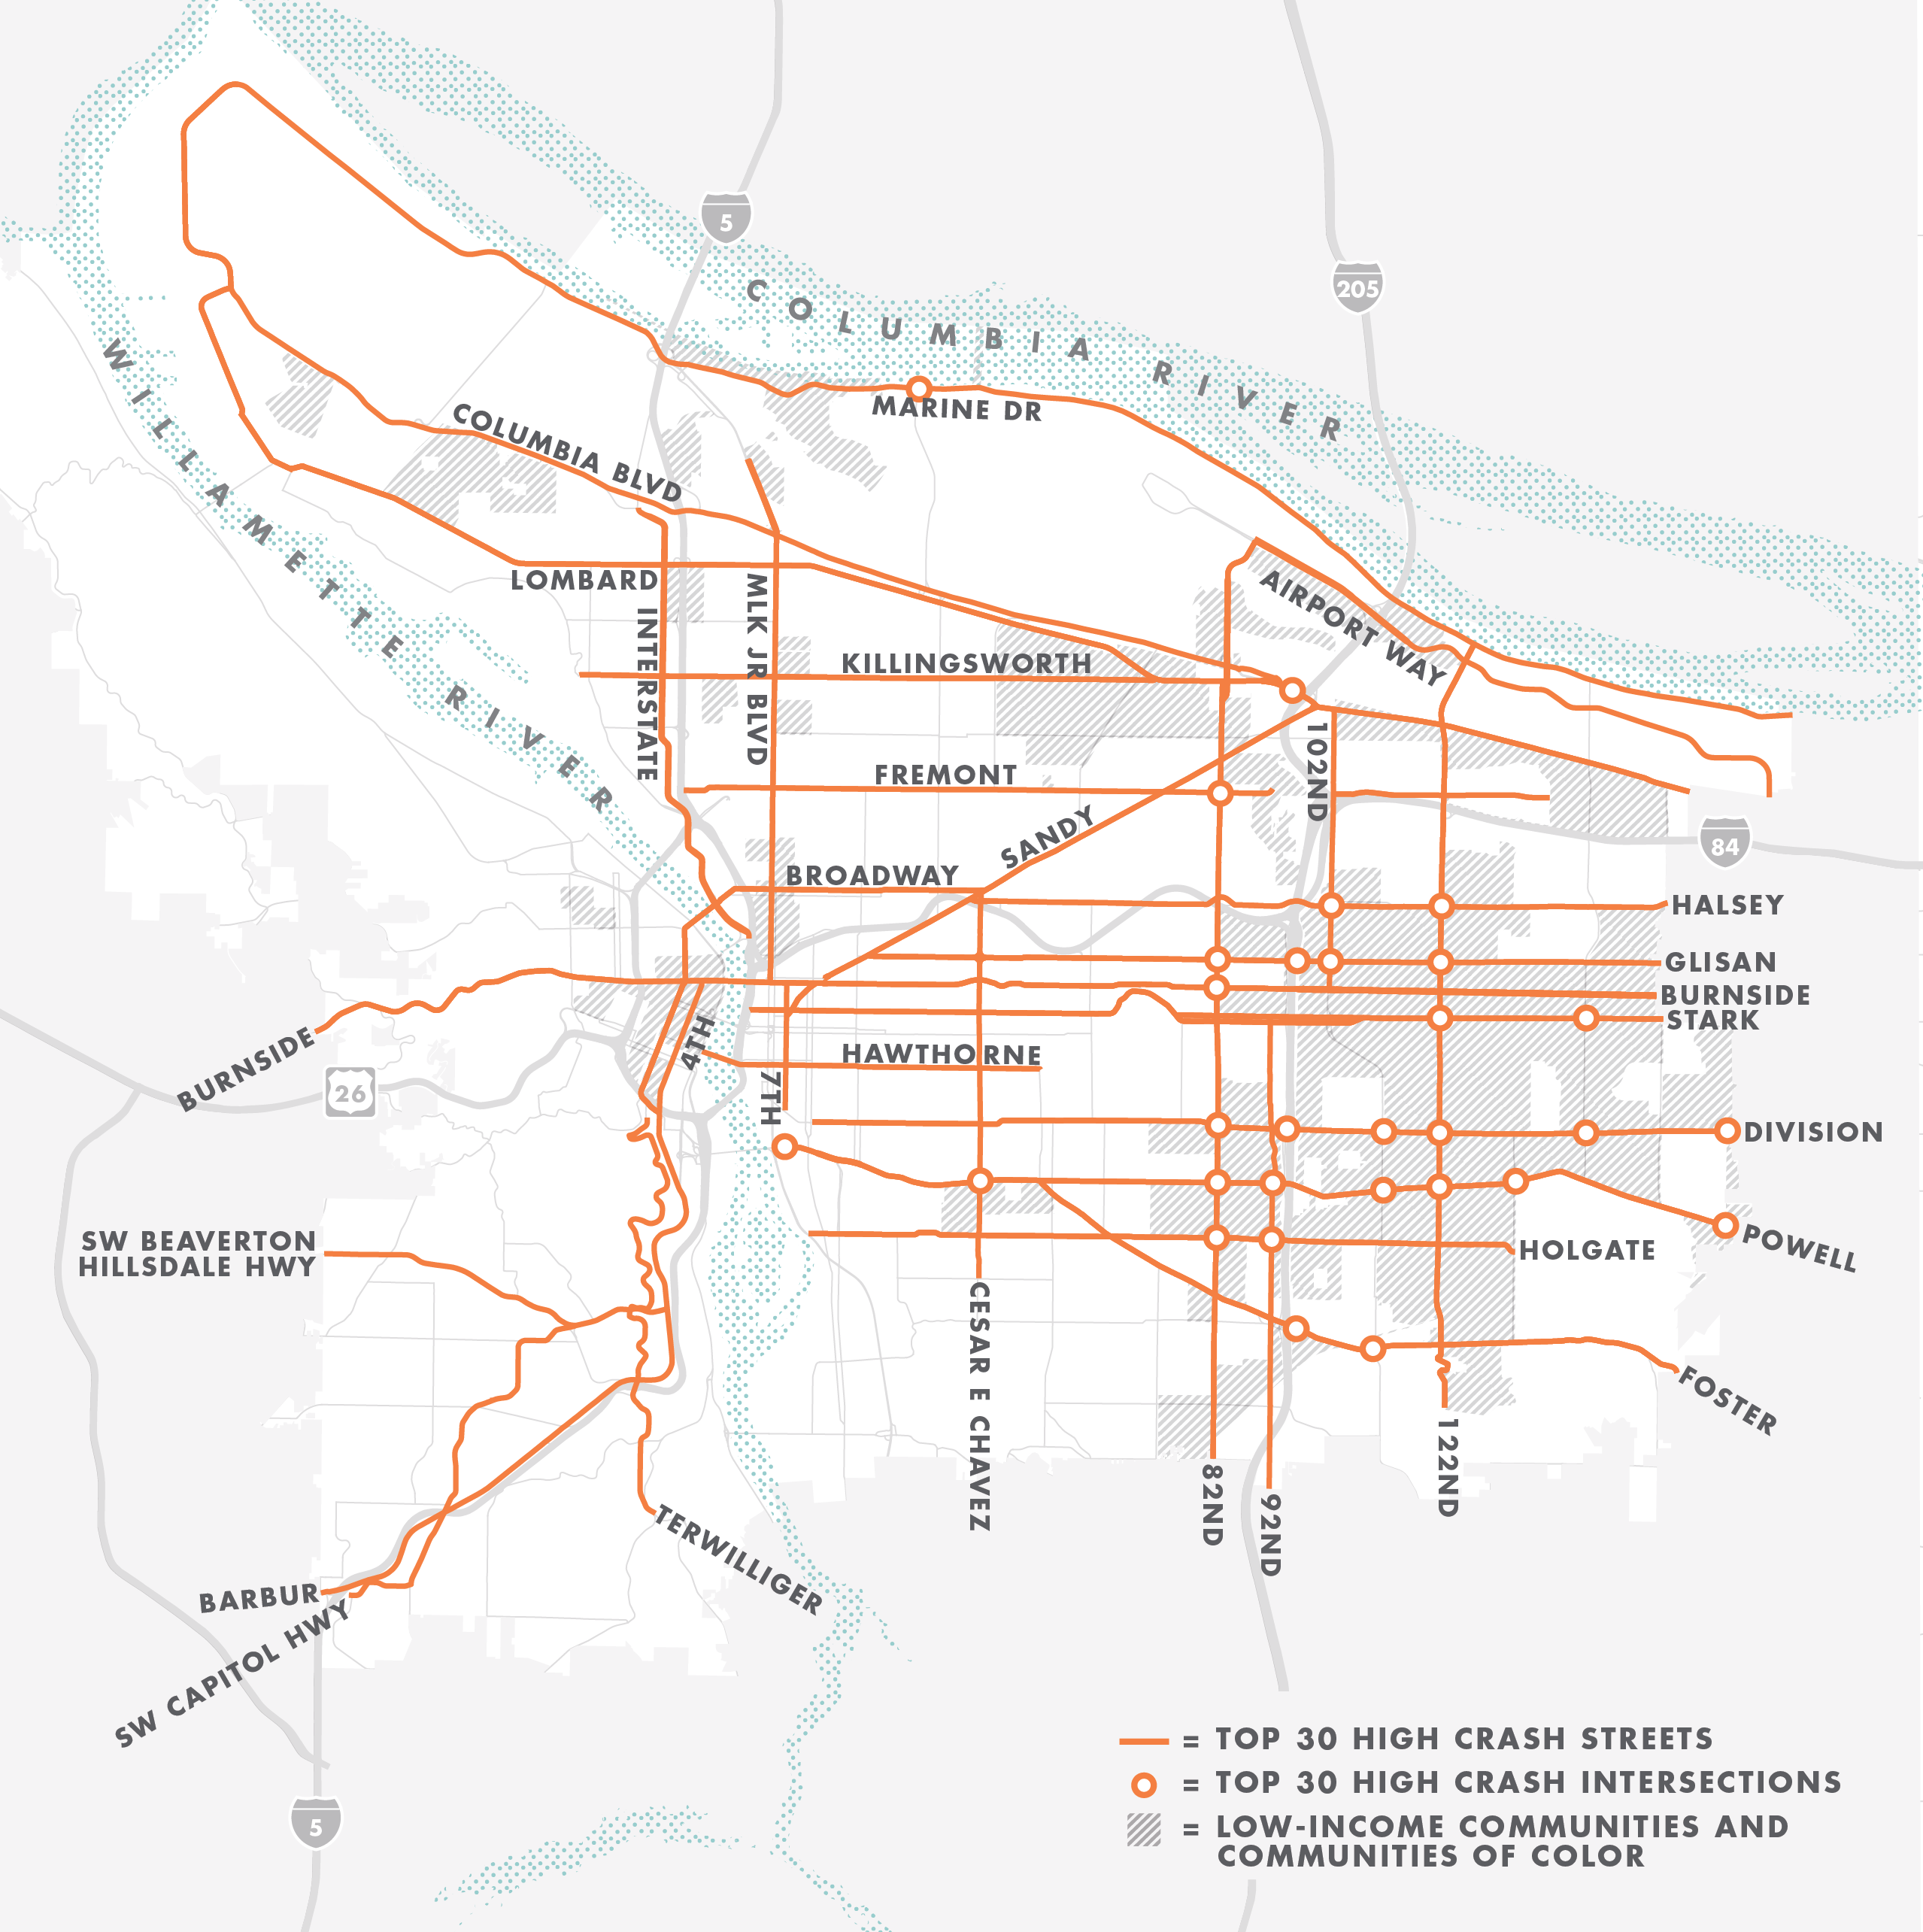
High Crash Network

Slide 4
Contributing Factors to
PORTLAND traffic deaths
STREET DESIGN 57%
SPEED 47%
IMPAIRMENT 56%

Slide 5
Vision Zero
Strategic Focus Areas
Protect pedestrians
Reduce speeds citywide
Design streets to protect human lives
Create a culture of shared responsibility

Slide 6
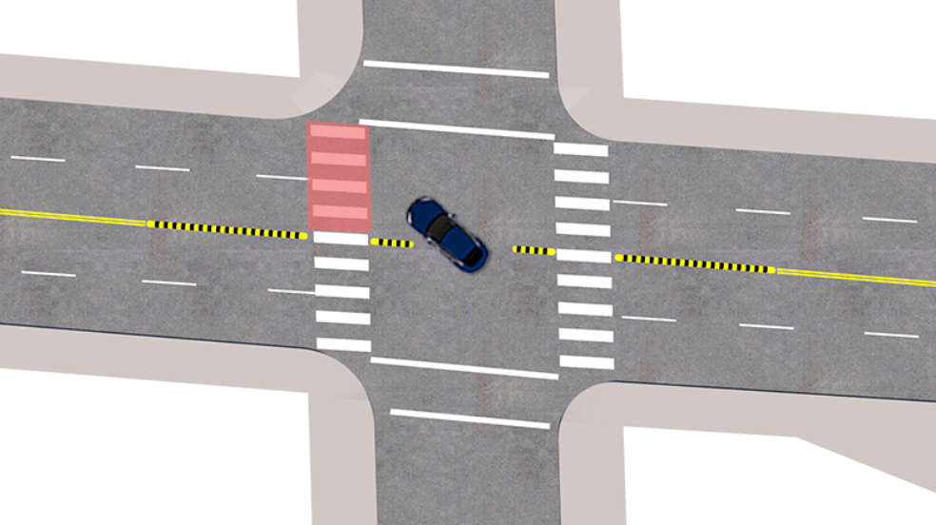
Protect Pedestrians
MOST COMMON CRASH TYPE
20% Left turning driver fails to yield to pedestrian in crosswalk at signalized intersection
WHERE CRASHES OCCUR
71% at intersections
Notes:
Nearly three-quarters of pedestrian crashes take place at intersections.
44% at Signalized intersections
27% at Unsignalized intersections
25% Midblock
4% Driveways
Most common crash types:
20%: Left turning driver fails to yield to pedestrian in crosswalk at signalized intersection
19%: Ped crossing between intersections at mid-block location
9%: Driver going straight fails to yield to ped in crosswalk at unsignalized intersection
Nearly half take place at signalized intersections.
Left turn calming in Lents (3 out of about 30)
SE Holgate Boulevard & 104th Avenue
SE Foster Road & 92nd Avenue SE Foster Road & 110th/111th avenues

Slide 7
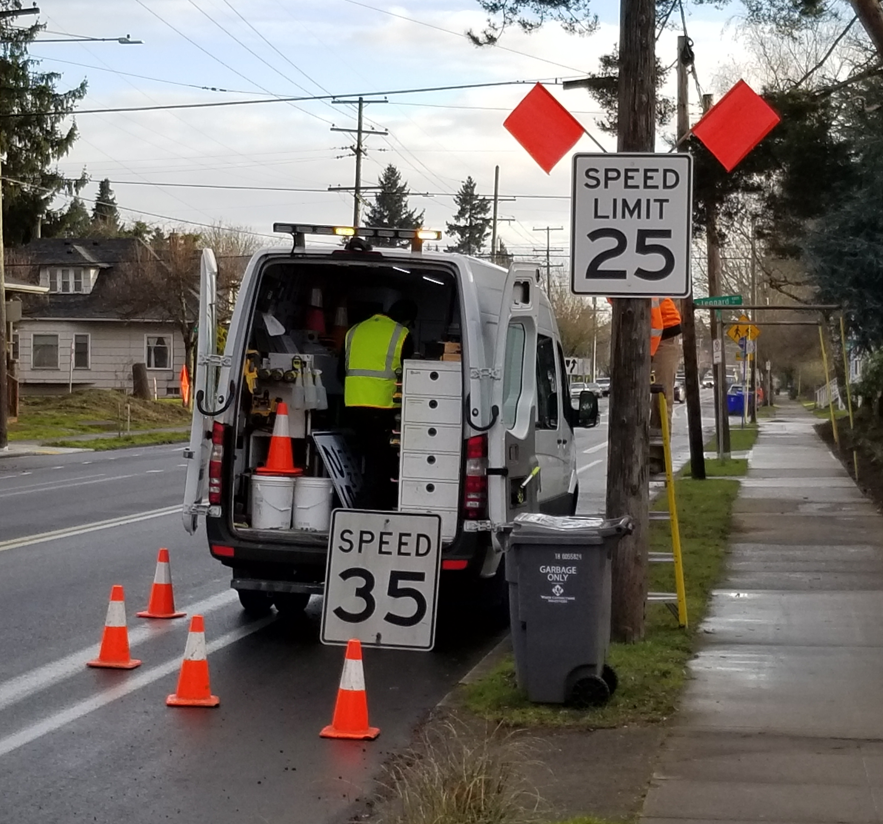
Reduce Speeds Citywide
Speed limits
Street design
Enforcement
Education

Slide 8
Reduce Speeds Citywide

Slide 9
Reduce Speeds Citywide

Slide 10
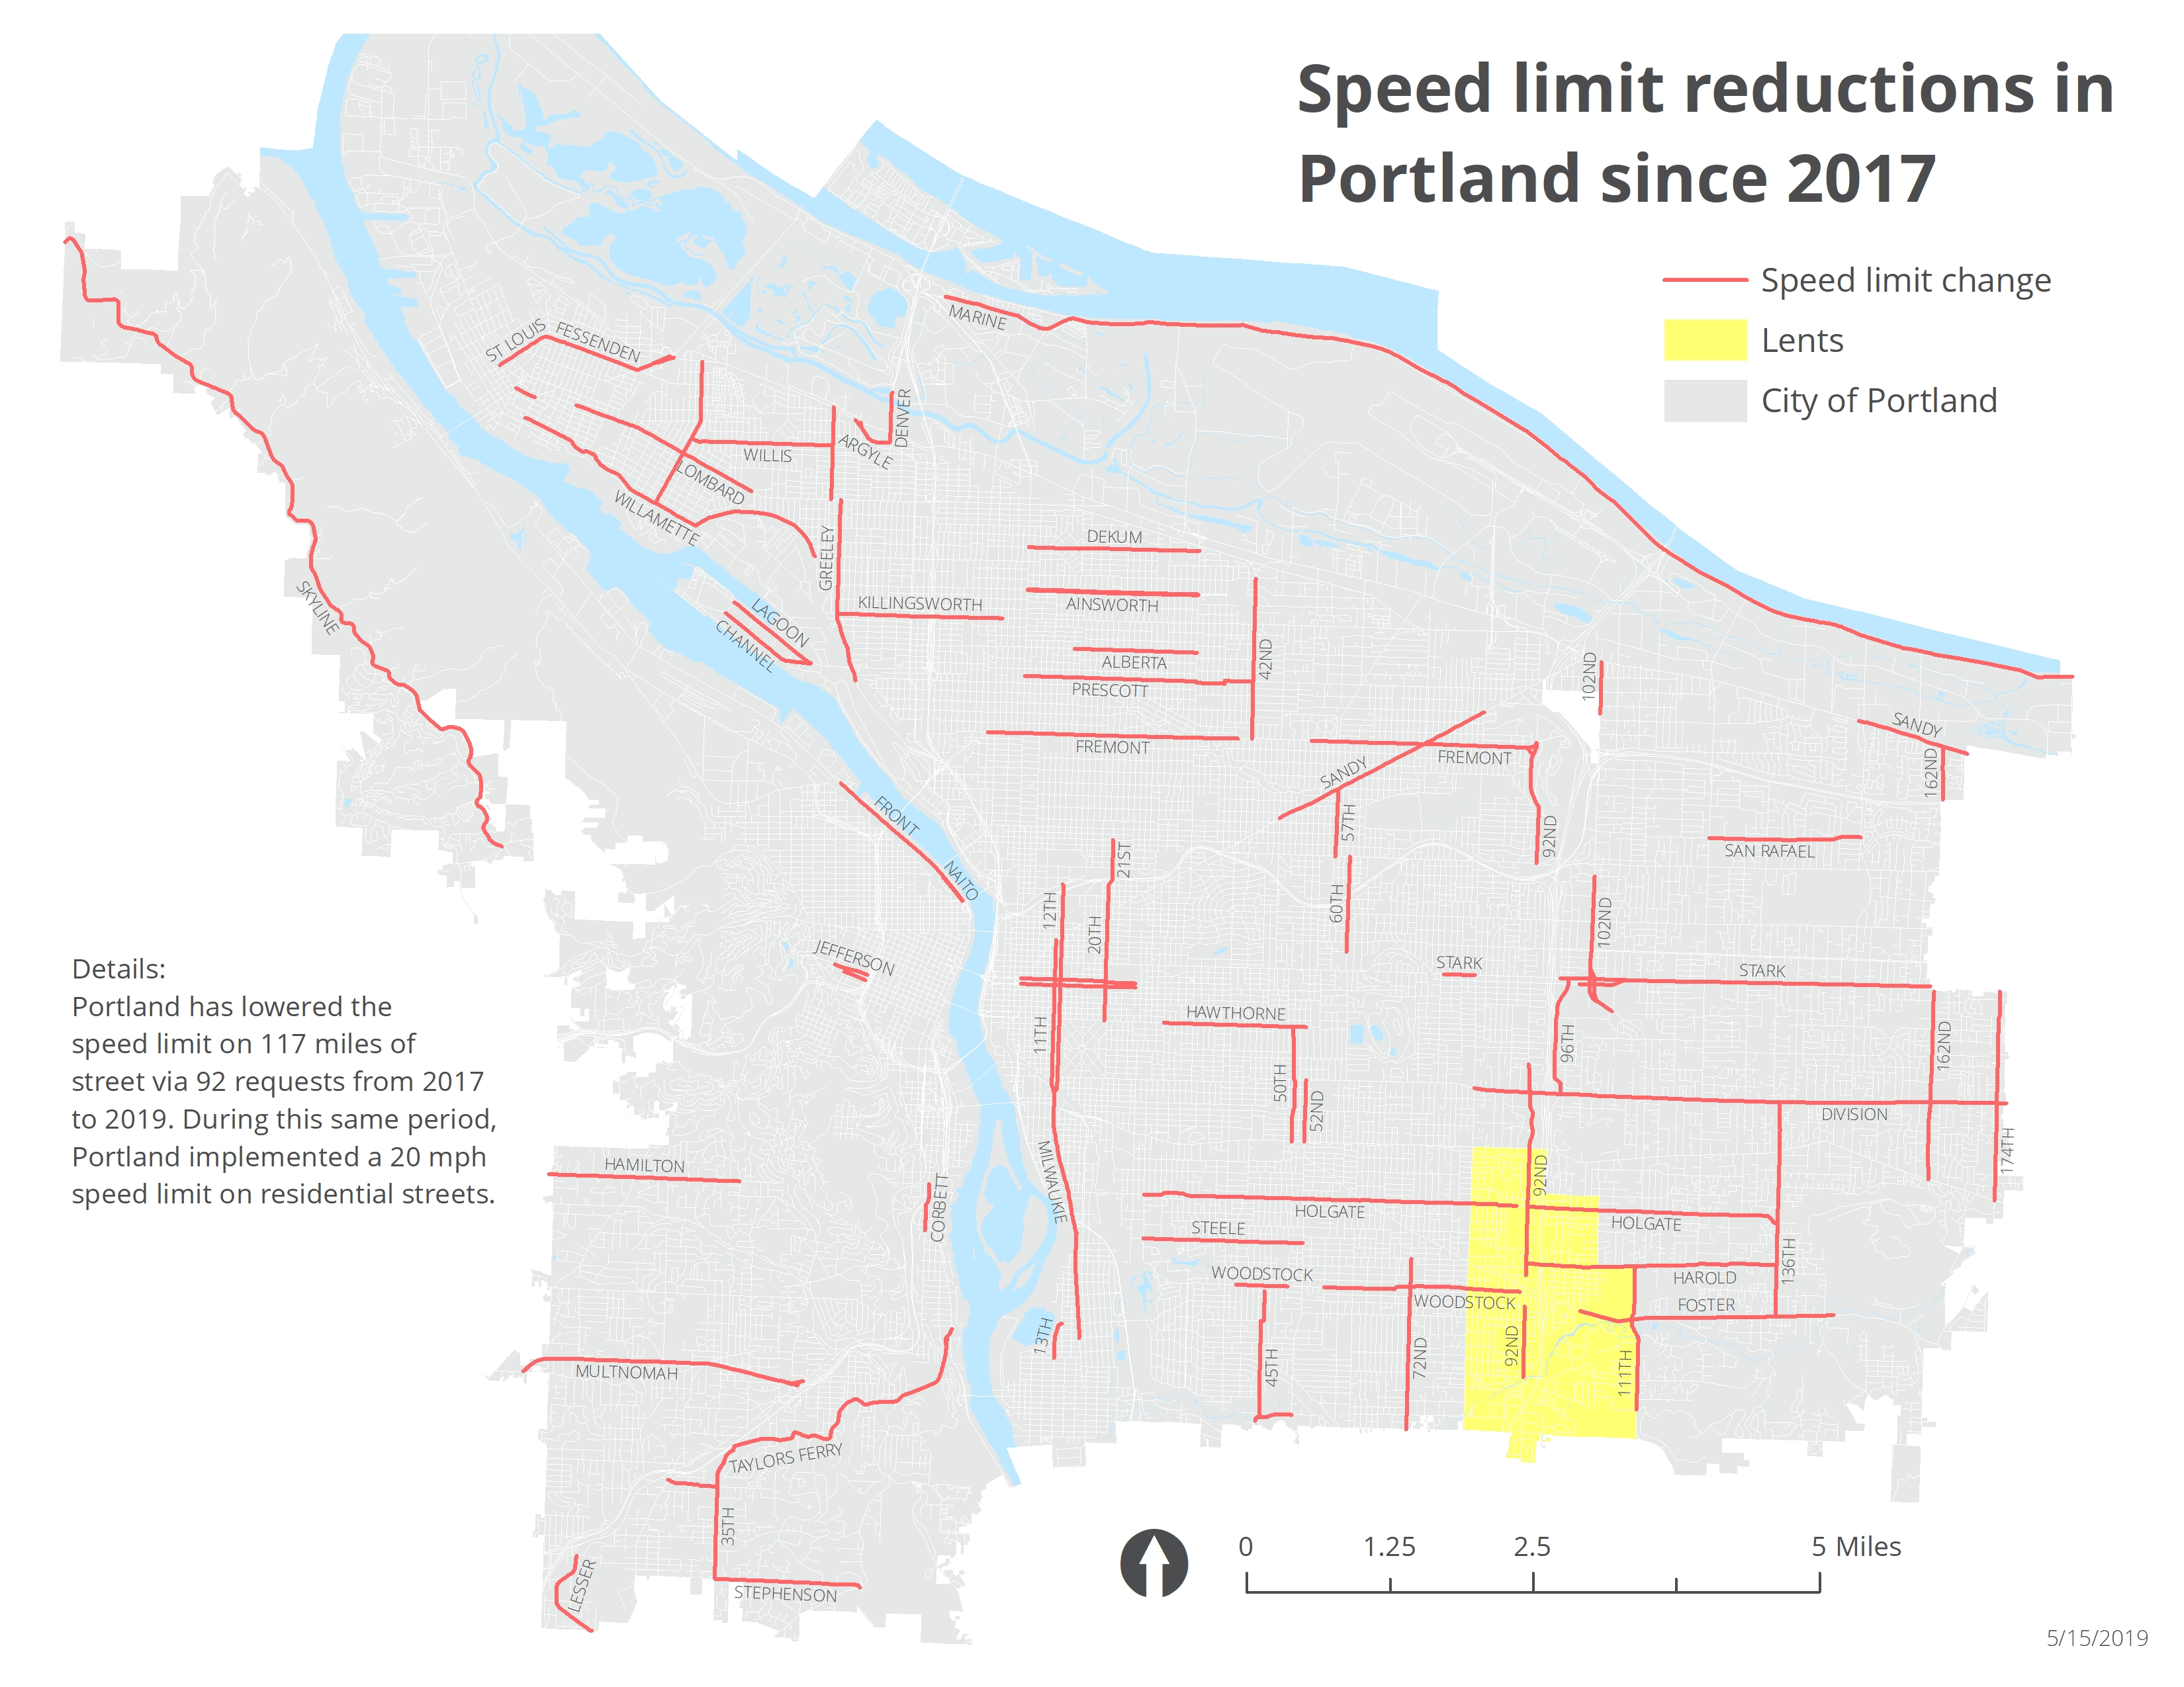
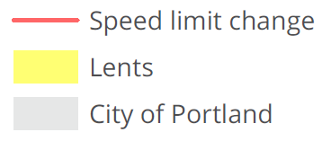
Reduce Speeds Citywide
Since 2017
Speed limit reductions on 117 miles of street (92 requests).
Plus 20 mph speed limit on residential streets.
Notes:
92nd: 35 to 30 mph
111th: 35 to 30 mph
Holgate: 30 to 25 mph (35 to 30 mph in 2017)
Harold: 30 to 25 mph
Woodstock: 35 to 30 mph
Foster: 40 to 35 mph

Slide 11
Design Streets to Protect Human Lives
Notes:
We are also working to manage speeds through street design.
This is a photo of one of our highest crash arterial streets as it exists today.

Slide 12
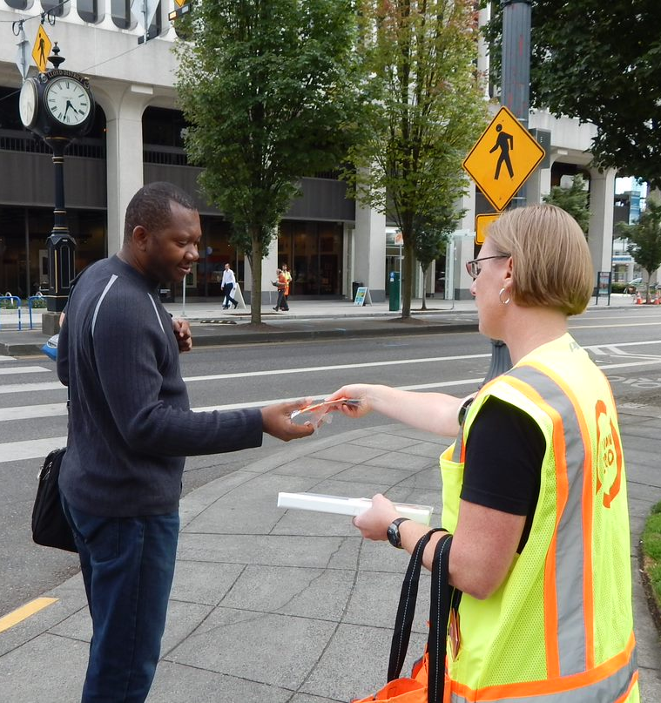
Create a Culture of Shared Responsibility

Slide 13
Thank you
Clay Veka
Vision Zero Program Coordinator
clay.veka@portlandoregon.gov
503-823-4998

Slide 14
EXTRA SLIDES

Slide 15
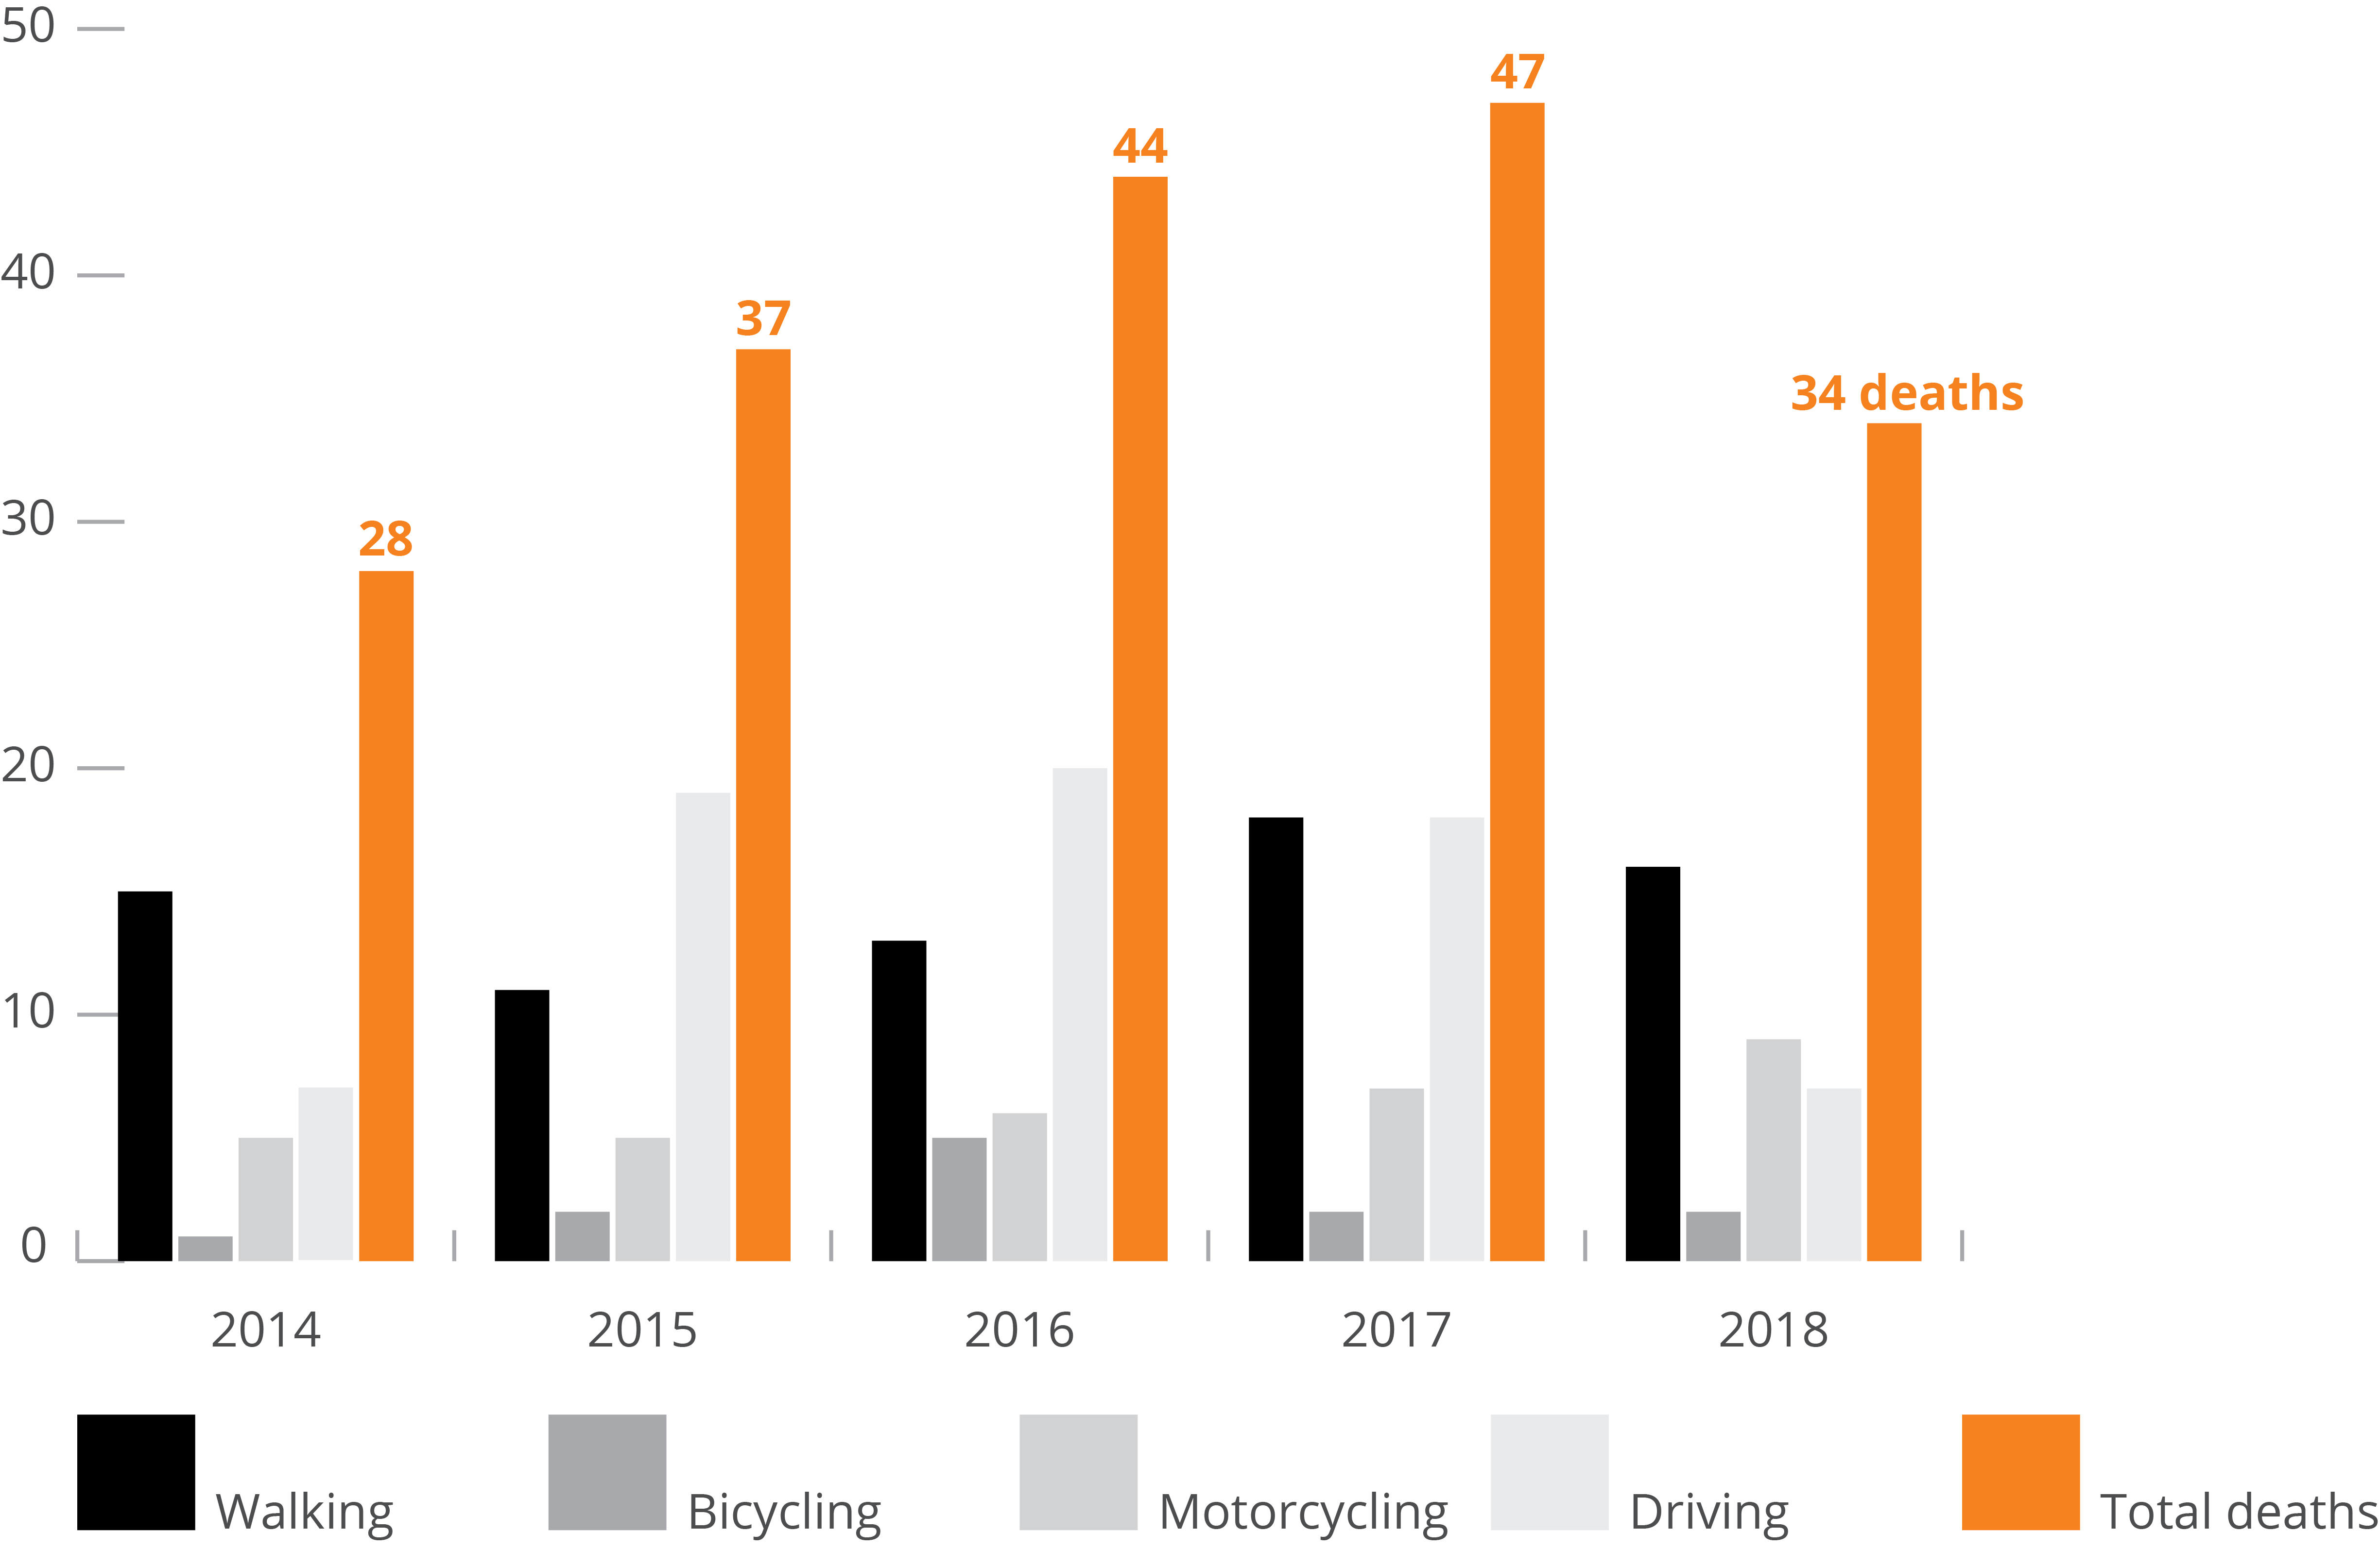
Pedestrian Safety
19
16
15
13
11
Notes:
2018 – 16
2017 – 19
2016 – 13
2015 – 11
2014 – 15

Slide 16
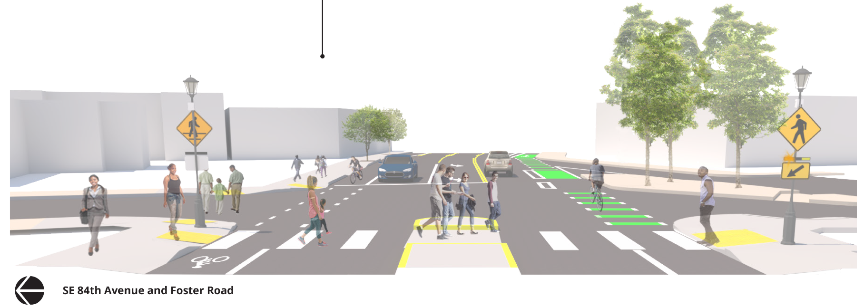
Design Streets to Protect Human Lives

